Slide 1

WE WILL MAKE FOR YOU
ASWATHY VIJAYAN
IRIN MARIA ELDOS
RIYA ELSA SUNNY
SMRITI SRINIVAS
MODEL ENGINEERING COLLEGE, THRIKKAKKARA
1’st year EEE

Slide 2
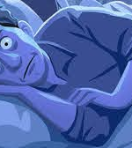
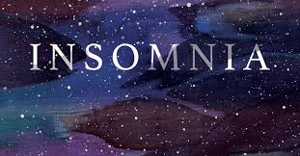
Insomnia is a sleep disorder that is characterized by difficulty falling and/or staying sleep.
People with insomnia have one or more of the following symptoms:
* Difficulty falling asleep.
* Waking up often during the night and
having trouble going back to sleep.
* Waking up to early in the morning.
* Feeling tired upon walking.

Slide 3
REAL CAUSE…
1.Stress
2.Jet lag
3.Poor sleep habits
4.Late dinner
5.Drinking too much coffee
6.Not sleeping on a regular schedule due to work or travel
7.Smoking

Slide 4
How Insomnia Affect US…
#1.Increased risk for medical conditions,
This may include:
stroke, asthma attacks, seizures, weak immune system, sensitivity
to pain-inflammation, obesity, diabetes mellitus, high blood
pressure, heart disease
#2. Increased risk for accidents
#3.Performance at work or school
memory-judgement
#4.Shortened life expectancy

Slide 5
OUR AIM
#1.Our team aims to help millions to tackle insomnia.
#2.A person who register for this website will be accessed and will be given advise to improve his sleep.
#3.The website also aims to keep track on the sleep ,food and exercise of the person and help them to lead a healthy life style.

Slide 6
OUR FEATURES
#1.Records all information of the registered person.
#2.Provide him/her suggestions after proper analysis by experts.
#3.System to track the sleep of a person.
#4.System to track the exercise of the person.
#5.Provide with journals and facility to decide the audience of the journals.
#6.Points awarded after the completion of each task.

Slide 7
HOW WE WORK…..
#1.Anyone can register to the website through their e-mail.
#2.Soon after registering, the person will be given a survey in which he need to fill up:
*Age
*Gender
*How many hours of quality sleep is he getting
*Does he smoke
*Does he drink coffee
*Is he stressed

Slide 8
THE WORKS..
#3. According to his response the website will suggest him some life style changes as advised by doctors and phsychiatrists.
#4.The website will notify him to sleep and wake up at the correct time.
#5.If necessary, the website will give him tasks life to exercise daily and will notify about this as well. Upon completion of each task, he will be given points.
#6.If insomnia is due to stress, then the website will advise him based on the stress level.

Slide 9
The works…
#7.The website also provide platform for users to write journals. The user can keep the journal private or share with others if they wish to do so.
#8.If it cannot cured through lifestyle changes, the website will recommend any nearby doctors.

Slide 10
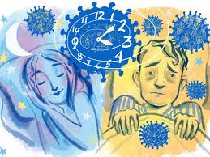
“INSOMNIA”………
It’s not a thing that you only have…….
If you are insomniac, just treat it with calm mind and healthy body….
Don’t get tensed….because it is not all because of you…and it can be cured with proper mindset and right routines….

Slide 11

“ WE ARE HERE TO HEAR YOU, TO TREAT YOU, AND TAKE YOU TOO A SOOTHING LIFESTYLE….WITH A CALM AND HEALTHY, SLEEP……”
WE WILL MAKE YOU WELL

